Slide 1


Chapter 2 – Data Representation

Slide 2
Chapter Contents
    2.1 Fixed Point Numbers
    2.2 Floating-Point Numbers
    2.3 Character Codes
Notes:
Computers only understand 0 and 1 — so how does your name, your salary, and your GPA exist inside the machine?
The three sections (2.1, 2.2, 2.3) as answers to that question:
Integers → fixed point
Real numbers → floating point
Text → character codes

Slide 3
What Are Fixed-Point Numbers?
fixed-point numbers are one way computers present data, especially whole numbers like 5, 10, or 25.
What computer see? And what do we see? – how about number ‘5’?

Slide 4
Computer only understand electric signal – ON or OFF – which we call 1s and 0s (binary)
We see ‘5’ but the computer will see 0101 in binary
This is called a fixed-point representation == because each binary digit (bit) stays in a fixed position that has a certain value
Lets imagine small computer 4 bits to count
Binary Position | 8 | 4 | 2 | 1
Bit Value | b3 | b2 | b1 | b0
Notes:
if you want to represent the number 10
8 – 4 – 2 - 1
1 – 0 – 1 - 0

Slide 5
Decimal | Binary | Meaning
0 | 0000 | All bits off
1 | 0001 | Only 1 is on
2 | 0010 | The ‘2’ place is on
5 | 0101 | 4+1 = 5
10 | 1010 | 8+2 = 10
15 | 1111 | 8+4+2+1 = 15

Slide 6
Fixed Point Numbers
Fixed Point Numbers
Represent integers.
Bits represent powers of 2
Signed or unsigned.
Example:
  Unsigned: 00001010 = 10
  2’s complement: 11110110 = -10
🧩 Use for: counting, addresses, indexes.

Slide 7
Fixed Point Numbers
In computing, a fixed-point number representation is a real data type for a number that has a fixed number of digits after (and sometimes also before) the radix point (after the decimal point '.' in English decimal notation).
In a fixed-point numbers system, each number has exactly the same number of digits, and the ‘point’ is always in the same place.
• Using only two digits of precision for signed base 10 numbers, the range (interval between lowest and highest numbers) is
[-99, +99] and the precision (distance between successive numbers) is 1.

Slide 8
Fixed Point Numbers
Range and Precision in Fixed-Point Representation
Computers can represent only a finite number of values.
Precision = smallest difference between two representable numbers.
Maximum Error = ½ × (precision step).
  Example: if step = 1 → max error = 0.5
Range → The largest and smallest values that can be represented with the available bits.
  Example: with 8 bits → 0 to 255 (unsigned)
In the real world, values are infinite, but inside a computer, they are limited — so rounding and error are inevitable.
Notes:
Computers can’t store an infinite number of decimals. When a real number doesn’t fit exactly, it’s rounded to the nearest value that does fit. The biggest possible rounding gap is half of one precision step.

Slide 9
Real World Numbers: |----|----|----|----|----|
3.0 3.5 4.0 4.5 5.0 5.5
Computer Knows Only: |----|----|----|
3.0 4.0 5.0
4.3 → stored as 4.0 (error = 0.3)
Maximum possible error = 0.5
Notes:
Example
Imagine a ruler with marks every 1 cm only.
You want to measure 3.4 cm.
You can only round to the nearest mark → 3 cm or 4 cm.
The maximum possible error is ½ cm.
Now, replace the ruler with a computer:
Each “mark” is a binary step (the precision).
Each rounding is the representation error.

Slide 10
Binary step
A binary step is simply the smallest difference between two consecutive numbers that a computer can represent using binary.
Integer (no fraction bits) ==
With fractional bits ==
000 = 0
001 = 1
010 = 2
011 = 3
100 = 4
0.000 = 0.0
0.001 = 0.125
0.010 = 0.25
0.011 = 0.375
0.100 = 0.5
Each number increases by 0.125.
That’s 1 / 2³ = 1/8 = 0.125

Slide 11
Binary step
Concept | Meaning
Binary step | The gap between two consecutive representable binary numbers
Depends on | How many fractional bits are used
Formula | Binary Step = 1 / 2ⁿ, where n = number of fraction bits
Example (3 bits) | 1 / 2³ = 0.125
The binary step determines:
Precision → how finely you can represent numbers.
Smaller steps = higher precision.
Maximum Error → half the binary step.
(Because when rounding, you can be off by at most half a step.)

Slide 12
Fixed Point Numbers
If we choose a = 70, b = 40, and c = -30, then a + (b + c) = 80 (which is correct) but (a + b) + c = -30 which is incorrect.
The problem is that (a + b) is +110 for this example, which exceeds the range of +99, and so only the rightmost two digits (+10) are retained in the intermediate result. This is a problem that we need to keep in mind when representing real numbers in a finite representation.
Notes:
In early mathematics, we learned the associative law of algebra:
a + (b+ c) = (a+ b) + c
Does not always hold for fixed-point number having a finite representation.
Example :- range [-99,99]…but 110 outside the range of number system→ gave overflow in an intermediate calculation even though the correct final result would be within the number system.

Slide 13
What We Just Learned —
Fixed-Point Numbers
Computers represent real-world numbers using a fixed number of bits.
  Binary point (like a decimal point) is fixed in position.
  Limited range → how big/small a number can be.
  Limited precision → smallest difference between values.
  Introduced the idea of binary step and maximum error.
Notes:
101.101 (in binary) represents 5.625 (in decimal).

Slide 14
What “radix” (or base) means
Every number system has a base (radix), which tells you:
  how many different symbols (digits) you can use, and
  what powers of the base each position represents.

Slide 15
The general formula
System | Radix (Base) | Digits allowed | Example
Decimal | 10 | 0–9 | 541.25₁₀
Binary | 2 | 0–1 | 1101.101₂
Octal | 8 | 0–7 | 723.5₈
Hexadecimal | 16 | 0–9, A–F | 2F.A₁₆
dₙ dₙ₋₁ … d₂ d₁ d₀ . d₋₁ d₋₂ d₋₃

Slide 16
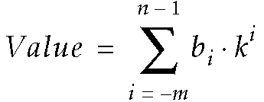
Radix (or base) Number System
The base, or radix of a number system defines the range of possible values that a digit may have: 0 – 9 for decimal; 0,1 for binary.
The general form for determining the decimal value of a number is given by:
Example:
541.25₁₀ = 5 × 10² + 4 × 10¹ + 1 × 10⁰ + 2 × 10⁻¹ + 5 × 10⁻²
= (500)₁₀ + (40)₁₀ + (1)₁₀ + (2/10)₁₀ + (5/100)₁₀
= (541.25)₁₀
Notes:
n = digits to the left
m = digits to the right
k = radix or base
i = position
b = value at the given position
Used to convert a num in any base into a base 10 number (polynomial method)
(1010.01)₂ → refer buku page 30
MSB (Most Significant Bit) = carries most weight (leftmost)
LSB (Least Significant Bit) = carries least weight (rightmost)

Slide 17
Why this matters
Once you understand this pattern for base 10, you can reuse the same idea for any radix:
Replace 10 with 2 for binary
Replace 10 with 8 for octal
Replace 10 with 16 for hexadecimal

Slide 18
Let’s apply the same radix formula to a hexadecimal (base 16) example.
2F.A₁₆
Decimal | Hex digit | Decimal | Hex digit
0 | 0 | 8 | 8
1 | 1 | 9 | 9
2 | 2 | 10 | A
3 | 3 | 11 | B
4 | 4 | 12 | C
5 | 5 | 13 | D
6 | 6 | 14 | E
7 | 7 | 15 | F

Slide 19
Pattern recap
System | Example | Base | Formula | Result
Decimal | 541.25₁₀ | 10 | ∑(digit×10^position) | 541.25
Binary | 1101.101₂ | 2 | ∑(digit×2^position) | 13.625
Hex | 2F.A₁₆ | 16 | ∑(digit×16^position) | 47.625

Slide 20
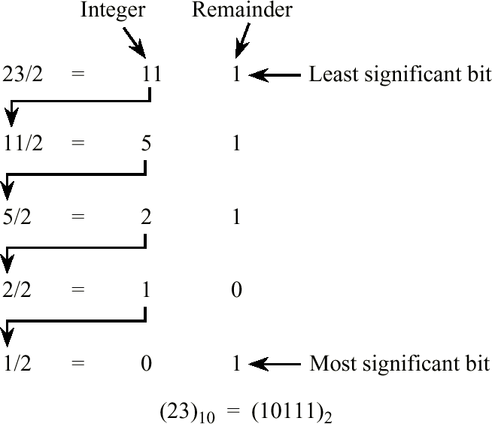
Base Conversion with the Remainder Method
Example: Convert 23.375₁₀ to base 2. Start by converting the integer portion:
(23.375)₁₀ = (23)₁₀ + (.375)₁₀
Notes:
To convert base 10 into any base.
Separate the integer & fraction
Integer use remainder method
divide with the intended base until the quotient is 0
use the remainder and write it starting from down (MSB) to up (LSB)

Slide 21
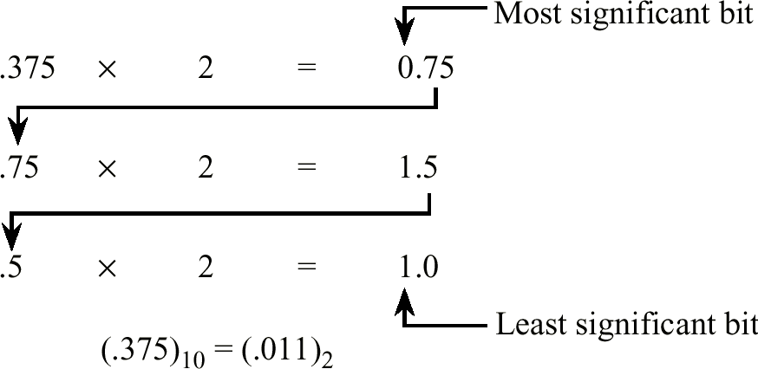
Base Conversion with the Multiplication Method
• Now, convert the fraction:
• Putting it all together, 23.375₁₀ = 10111.011₂
Notes:
Fraction use multiplication method
multiply (only the fraction part) it with 2 (the intended base)
stop if the fraction portion is 0
or if we have reach the precision limit
collect the integer part and write it from up (MSB) to down (LSB)

Slide 22
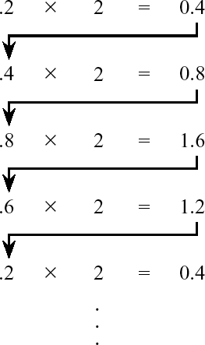
Nonterminating Base 2 Fraction
• We can’t always convert a terminating base 10 fraction into an equivalent terminating base 2 fraction:
Notes:
Binary vs decimal.
Some calculators & business computer used base 10 (decimal), why?
To avoid the terminating fraction problem, and
Avoid the conversion process (at I/O)
However, majority application use base 2 (binary)

Slide 23
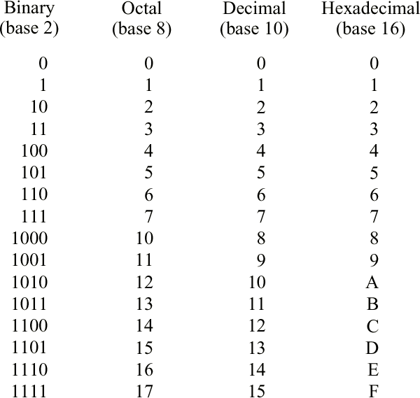
Base 2, 8, 10, 16 Number Systems
Example: Show a column for ternary (base 3). As an extension of that, convert 14₁₀ to base 3, using 3 as the divisor for the remainder method (instead of 2). Result is 112₃
Notes:
Ternary (base 3)
0 1 2 10 11 12 20 21 22 100 101 102 110 111 112 120 121 200
14/3 = 4 2
4/3 = 1 1
1/3 = 0 1
Ans = 112 base 3
General rule →, use the polynomial method when converting into base 10, and use the remainder and multiplication method when converting out of base 10.

Slide 24
More on Base Conversions
• Converting among power-of-2 bases is particularly simple:
1011₂ = (10₂)(11₂) = 23₄
23₄ = (2₄)(3₄) = (10₂)(11₂) = 1011₂
101010₂ = (101₂)(010₂) = 52₈
01101101₂ = (0110₂)(1101₂) = 6D₁₆
Notes:
Base 4 _ _ (1 digit = 2 bits)
Base 8 _ _ _ (1 digit = 3 bits)
Base 16 _ _ _ _ (1 digit = 4 bits)

Slide 25
What are "power-of-2 bases"?
Base | Name | Relation
2 | Binary | 2¹
4 | Base-4 | 2²
8 | Octal | 2³
16 | Hexadecimal | 2⁴
Each digit in these bases can be replaced by a fixed number of binary bits:
Base | Bits per digit | Example
Base 4 | 2 bits | 0–3 → 00–11
Base 8 | 3 bits | 0–7 → 000–111
Base 16 | 4 bits | 0–F → 0000–1111

Slide 26
Self test
What is the range of digits allowed in:
a. Base 8
b. Base 10
c. Base 16
Convert the following binary numbers to decimal.
a. 1011₂
b. 1101.101₂
c. 111010₂
Convert 13.247₁₀ to binary. Show your working for:
  Integer division by 2
  Fractional multiplication by 2

Slide 27
Binary ↔ Power-of-2 Bases
Convert these binary numbers to base 4:
a. 1011₂
b. 111010₍₂₎
Convert the following base 4 numbers to binary:
a. 32₄
b. 123₄
Convert these binary numbers to octal (base 8):
a. 101010₂
b. 111100₂
Convert these binary numbers to hexadecimal (base 16):
a. 01101101₂
b. 11011111₂

Slide 28
Base 4 uses 2 bits per digit because
10 11
4 = 2².
1011₂ = 23₄
Convert binary to base 8 (octal)
Each base-8 digit = 3 bits, because 8 = 2³.
101010₂ → ?₈
101 010 == 52₈

Slide 29
Conversion Practice
a. Convert these unsigned 4-bit numbers to decimal:
0101₂, 1110₂, 0011₂.
b. Convert these signed (two’s complement) 4-bit numbers to decimal:
1101₂, 1001₂, 0110₂.

Slide 30
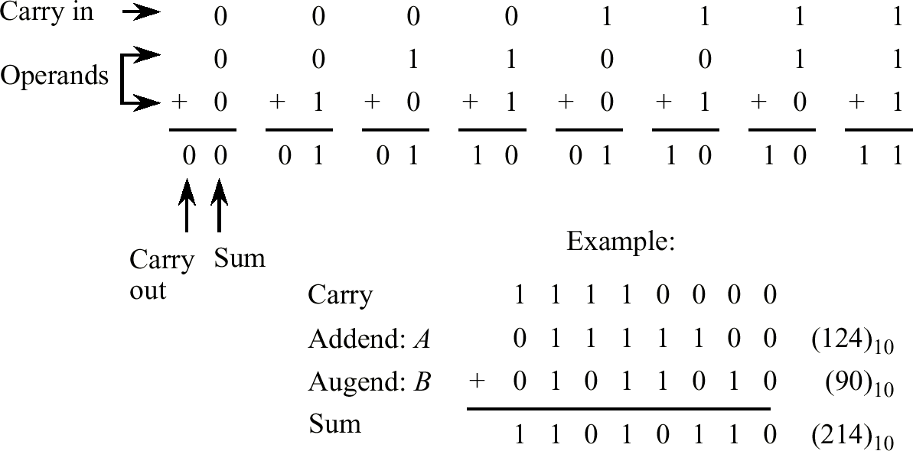
Binary Addition
• This simple binary addition example provides background for the signed number representations to follow.

Slide 31
Binary Digits (Bits)
In binary, you only have two digits:
0 and 1.
So when you add them together, you only have four possible combinations:
Bit A | Bit B | Result
0 | 0 | 0
0 | 1 | 1
1 | 0 | 1
1 | 1 | 10 (which means 0 with a carry of 1)
That last one is the important one.
When you add 1 + 1, it equals 10 in binary — that’s 2 in decimal, so:
You write down 0 (the rightmost bit)
Notes:
When you add 1 + 1 in binary:It equals 2 in decimal.But since you can’t write “2” in binary, you write 10 instead.The “1” on the left means “carry over into the next column.”
9 + 5 = 14 → write 4, carry 1 to the tens column
1 + 1 = 10 → write 0, carry 1 to the twos column
So 10₂ = 2₁₀

Slide 32
Signed Fixed Point Numbers
  • For an 8-bit number, there are 2⁸ = 256 possible bit patterns. These bit patterns can represent negative numbers if we choose to assign bit patterns to numbers in this way. We can assign half of the bit patterns to negative numbers and half of the bit patterns to positive numbers.
  • Four signed representations we will cover are:
  Signed Magnitude
  One’s Complement
  Two’s Complement
  Excess (Biased)

Slide 33
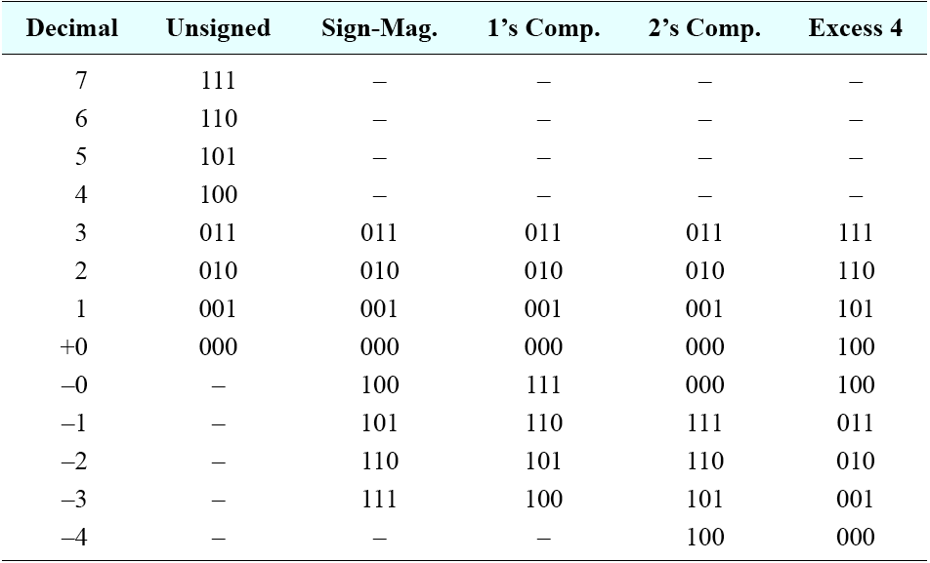
3-Bit Signed Integer Representations

Slide 34
Signed Magnitude
  • Also know as “sign and magnitude,” the leftmost bit is the sign
  (0 = positive, 1 = negative) and the remaining bits are the magnitude.
  • Example:
  +25₁₀ = 00011001₂
  -25₁₀ = 10011001₂
  • Two representations for zero: +0 = 00000000₂, -0 = 10000000₂.
  • Largest number is +127, smallest number is -127₁₀, using an 8-bit representation.
Notes:
Representation is most familiar to us in the base 10 number system.
Zero can be represented as +0 & -0, thus
Possible num 2⁸ – 1 = 255 (because +0 and -0 represent same number)
Range [+127, -127]

Slide 35
Signed Magnitude (simple but old)
Binary | Meaning
0000 | +0
0001 | +1
0010 | +2
0011 | +3
0100 | +4
1000 | -0 ❌
1001 | -1
1010 | -2
1011 | -3
1100 | -4
Range: -7 to +7
Problem: two zeros (+0 and -0)

Slide 36
One’s Complement
  • The leftmost bit is the sign (0 = positive, 1 = negative). Convert all of the 1s in the number to 0s and all of the 0’s to 1s.
  Example:
  +25₁₀ = 00011001₂
  -25₁₀ = 11100110₂
  • Two representations for zero: +0 = 00000000₂, -0 = 11111111₂.
  • Largest number is +127₁₀, smallest number is -127₁₀, using an 8-bit representation.
Notes:
→ is known as complementing the bits.
Because +0 and -0 is the same number, possible num = 2⁸ – 1 = 255
Range [+127, -127]
Not commonly used in arithmetic calculations
Difficulty in making comparisons when there are two representations for 0

Slide 37
Binary | Decimal
0000 | +0
0001 | +1
0010 | +2
0011 | +3
0100 | +4
1011 | -4
1100 | -3
1101 | -2
1110 | -1
1111 | -0 ❌
Range: -7 to +7
Problem: two zeros again (+0 and -0)

Slide 38
Two’s Complement
  • The leftmost bit is the sign (0 = positive, 1 = negative). Negative of a number is obtained by adding 1 to the one’s complement negative. This goes both ways, converting between positive and negative numbers.
  • Example (recall that -25₁₀ in one’s complement is 11100110₂):
  +25₁₀ = 00011001₂
  -25₁₀ = 11100111₂
  • One representation for zero: +0 = 00000000₂, -0 = 00000000₂.
  • Largest number is +127₁₀, smallest number is -128₁₀, using an 8-bit representation.
Notes:
Since one representation of 0 = 000, the possible num = 2⁸ = 256
Range [+127, -128] because
positive number starts from 0, and negative num starts from -1.

Slide 39
Binary | Decimal
0000 | 0
0001 | 1
0010 | 2
0011 | 3
0100 | 4
0101 | 5
0110 | 6
0111 | 7
1000 | -8
1001 | -7
1010 | -6
1011 | -5
1100 | -4
1101 | -3
1110 | -2
1111 | -1
To get the negative:
Flip all bits
Add 1
Example:
+3 = 0011
Flip = 1100
Add 1 = 1101 → -3

Slide 40
Step | Action | Result | Meaning
Start | +3 | 0011 | Positive number
Flip bits | 0011 → 1100 | One’s complement
Add 1 | 1100 + 1 = 1101 | Two’s complement = -3
Check | 0011 + 1101 = 0000 | Works perfectly ✅

Slide 41
Excess (Biased)
  • The leftmost bit is the sign (usually 1 = positive, 0 = negative). Positive and negative representations of a number are obtained by adding a bias to the two’s complement representation. This goes both ways, converting between positive and negative numbers. The effect is that numerically smaller numbers have smaller bit patterns, simplifying comparisons for floating point exponents.
  • Example (Represent eight-bit format using an excess 128 representation) :
  +12₁₀ = 10001100₂
  -12₁₀ = 01110100₂
  • One representation for zero: +0 = 10000000₂, -0 = 10000000₂.
  • Largest number is +127₁₀, smallest number is -128₁₀, using an 8-bit representation.
Notes:
Excess representation, the number is treated as unsigned, but is “shifted” in value by subtracting the bias from it.
Excess value will be given. Add into the original number.
Example using excess 128 representation.
+12 = 128 + 12 = 140 = 1000 1100
-12 = 128 + (-12) = 116 = 0111 0100
Range [ +127 (1111 1111), -128 (0000 0000)]

Slide 42
In normal 4-bit unsigned numbers:
  0000 = 0
  0001 = 1
  0010 = 2
  ...
  1111 = 15
pick a “bias” number
  Let’s choose a bias of 7 (this is half of 15).
  That means we will shift all our numbers by 7.
  To get the real value, we use this formula:
  Real value = Stored value − Bias

Slide 43
Binary | Stored Value | Real Value = Stored − 7
0000 | 0 | 0 − 7 = −7
0001 | 1 | 1 − 7 = −6
0010 | 2 | 2 − 7 = −5
0011 | 3 | 3 − 7 = −4
0100 | 4 | 4 − 7 = −3
0101 | 5 | 5 − 7 = −2
0110 | 6 | 6 − 7 = −1
0111 | 7 | 7 − 7 = 0
1000 | 8 | 8 − 7 = +1
1001 | 9 | 9 − 7 = +2
1010 | 10 | 10 − 7 = +3
1011 | 11 | 11 − 7 = +4
1100 | 12 | 12 − 7 = +5
1101 | 13 | 13 − 7 = +6
1110 | 14 | 14 − 7 = +7
1111 | 15 | 15 − 7 = +8
“I’ll pretend 0000 means -7 instead of 0.”
Example:
1000
Step 1: Convert to decimal → 8
Step 2: Subtract the bias (7)
8 − 7 = 1
So 1000 means +1
How about: 0010
Notes:
Decimal = 2
Subtract bias → 2 − 7 = -5
So 0010 means -5
Excess or Biased numbers are like shifting the number line.
Instead of having a negative sign bit, we just add a fixed bias to every value.
To find the real number, we subtract the bias again.

Slide 44
Term | Meaning
Bias | The amount we add to shift all numbers up
Stored value | The raw binary value
Real value | Stored − Bias
Example bias | 7 (for 4 bits), 127 (for 8 bits)
Range (4-bit) | −7 to +8

Slide 45
Representation | How to get negative | Range (4-bit) | Example: +3 / -3
Signed Magnitude | Flip sign bit | -7 to +7 | +3=0011 / -3=1011
One’s Complement | Flip all bits | -7 to +7 | +3=0011 / -3=1100
Two’s Complement | Flip all bits + 1 | -8 to +7 | +3=0011 / -3=1101
Excess (Biased) | Subtract bias (7) | -7 to +8 | +3=1010 (10-7=3)

Slide 46
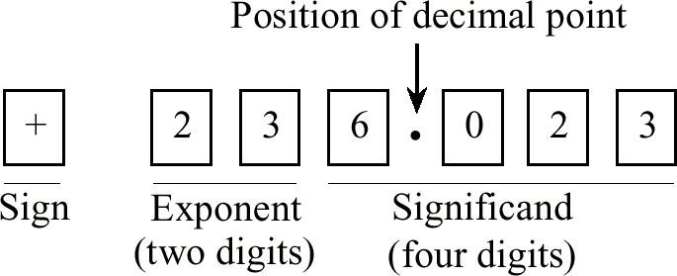
Base 10 Floating Point Numbers
  • Floating point numbers allow very large and very small numbers to be represented using only a few digits, at the expense of precision. The precision is primarily determined by the number of digits in the fraction (or significand, which has integer and fractional parts), and the range is primarily determined by the number of digits in the exponent.
  • The base 10 floating-point number representing Avogadro’s number
  Example (+6.023 × 10²³): 6023000000000000000000000
Notes:
Fixed-point portion referred to as the Significand or mantissa

Slide 47
Every floating-point number has three parts:
Part | Name | Example (6.023 × 10²³) | What it does
1 | Sign | + | Tells if it’s positive or negative
2 | Significand / Mantissa | 6.023 | The “main digits” of the number
3 | Exponent | 23 | Tells how many times to move the decimal point (by powers of 10)

Slide 48
floating point
it can move left or right depending on the exponent.
6.023 × 10²³ → move decimal 23 places to the right
6.023 × 10⁻²³ → move decimal 23 places to the left
The more bits or digits you give to the exponent → bigger range
The more bits or digits you give to the significand → more accuracy

Slide 49
Normalization
  • The base 10 number 254 can be represented in floating point form as 254 × 10⁰, or equivalently as:
  25.4 × 10¹, or 2.54 × 10², or
  .254 × 10³, or .0254 × 10⁴, or
  infinitely many other ways, which creates problems when making comparisons, with so many representations of the same number.
  • Floating point numbers are usually normalized, in which the radix point is located in only one possible position for a given number.
  • Usually, but not always, the normalized representation places the radix point immediately to the left of the leftmost, nonzero digit in the fraction, as in: .254 × 10³.
Notes:
Representing floating-point numbers is that the same number can be represented in different ways.
Positive exponent
Negative exponent
Hidden bit or hidden 1 → example: if the mantissa in a given format is .11010 after normalization, then bit pattern stored is 1010
The leftmost bit is truncated or hidden

Slide 50
What’s the problem?
Representation | Still means
254 × 10⁰ | 254
25.4 × 10¹ | 254
2.54 × 10² | 254
0.254 × 10³ | 254
0.0254 × 10⁴ | 254
How do you compare two floating point numbers correctly?
If you store all of these in a computer, how do you know they’re the same number?

Slide 51
Normalization means:
  We agree to write the number in only one format,
  where the decimal (radix) point is always in the same place.
The rule for normalization
  Usually (but not always), we move the decimal point so that there’s exactly one nonzero digit to its left.

Slide 52
Step | Action | Result
Start | 254 | 254 × 10⁰
Move decimal left 1 step | 25.4 × 10¹ | same value
Move decimal left again | 2.54 × 10² | Normalized!
Move again | 0.254 × 10³ | not normalized (zero before the decimal)
Because now the decimal point is right after the first nonzero digit (2).
Notes:
It gives every number one official version — no duplicates.
So:
254 × 10⁰,
25.4 × 10¹,
2.54 × 10²
All become standardized as
2.54 × 10²

Slide 53
Floating Point Example
  • Represent .254 ×10³ in a normalized base 8 floating point format with a sign bit, followed by a 3-bit excess 4 exponent, followed by four base 8 digits.
  • Step #1: Convert to the target base.
  .254 × 10³ = 254₁₀. Using the remainder method, we find that 254₁₀ = 376 × 8⁰:
  254/8 = 31 R 6
  31/8 = 3 R 7
  3/8 = 0 R 3
  • Step #2: Normalize: 376 × 8⁰ = .376 × 8³.
  • Step #3: Fill in the bit fields, with a positive sign (sign bit = 0), an exponent of 3 + 4 = 7 (excess 4), and 4-digit fraction = .3760:
  0 111 . 011 111 110 000
Notes:
_ _ _ _. _ _ _ _ _ _ _ _ _ _ _ _ ← draw this first (Refer page 42)
Fixed-point number into a floating-point number
Step 1 – base 10 to base 8, remainder method
Step 2 – normalize, left to the leftmost nonzero digit
Step 3 –
Sign bit = positive = 0
Exponent (excess 4) = 3 + 4 = 7 = 111
Significand = 4 digit fraction = 011(3) 111(7) 110(6) 000(0)

Slide 54
We need to represent this number: 0.254 × 10³ as a floating-point number, but in base 8 (octal), not base 10.
Part | Meaning
1 bit | Sign (positive or negative)
3 bits | Exponent (stored in “excess-4” form)
4 octal digits | Fraction part (mantissa)
[Sign bit] [Exponent (3 bits)] [Fraction (4 octal digits)]

Slide 55
Conversion Example
  • Example: Convert (9.375 × 10⁻²)₁₀ to base 2 scientific notation
  • Start by converting from base 10 floating point to base 10 fixed point by moving the decimal point two positions to the left, which corresponds to the -2 exponent: .09375.
  • Next, convert from base 10 fixed point to base 2 fixed point:
  .09375 × 2 = 0.1875
  .1875 × 2 = 0.375
  .375 × 2 = 0.75
  .75 × 2 = 1.5
  .5 × 2 = 1.0
  • Thus, (.09375)₁₀ = (.00011)₂.
  • Finally, convert to normalized base 2 floating point:
  .00011 = .00011 × 2⁰ = 1.1 × 2⁻⁴
Notes:
Step 1 – convert the floating point to fixed point (10⁰), moving to the left(+2)
Step 2 – convert to targeted base (base 10 to base 2)
Step 3 – normalize to the desired floating point, moving to the right(-4)

Slide 56
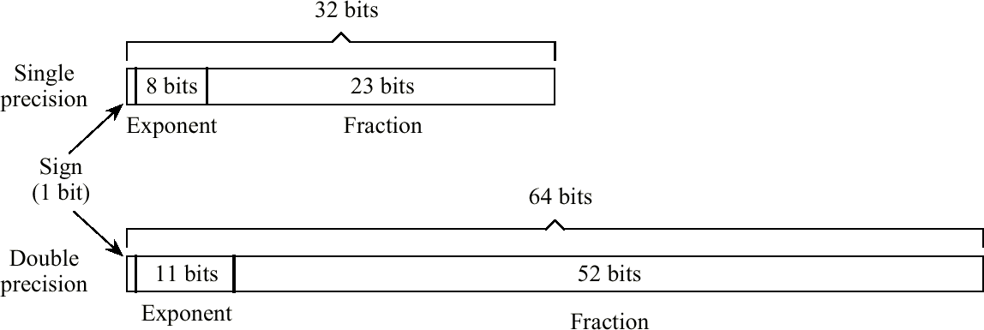
IEEE-754 Floating Point Formats
Notes:
Many ways to represent floating point number. Each representation has its own characteristics in terms of range, precision and the number of representable number.
The IEEE 754 floating-point standard for binary numbers was developed (IEEE,1985).
SP – 32 bits, DP – 64 bits
Sign bit, +ve (0) & -ve (1)
Exponent, for SP - 8-bits excess 127 &
for DP– 11 bit excess 1023 (pattern all 0s and all 1s are reserved)
All 0s is a ‘clean zero’ state (sign can be both, All 0s for exponent and fraction).
All 1s indicate infinity (sign can be both, all 1s for exponent and all 0s for fraction)
For fraction, LEFT of binary point will be hidden.

Slide 57
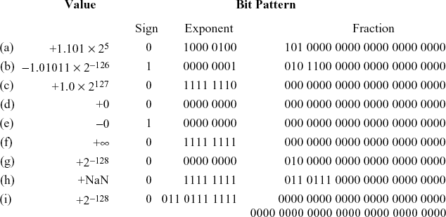
IEEE-754 Examples
Notes:
Sign
Example (a)
+ve sign = 0
Exponent 5 = 127+5 = 132 = 1000 0100
Fraction 1.101 = hide the left 1 = 101

Slide 58
IEEE-754 Conversion Example
  • Represent -12.625₁₀ in single precision IEEE-754 format.
  • Step #1: Convert to target base. -12.625₁₀ = -1100.101₂
  • Step #2: Normalize. -1100.101₂ = -1.100101₂ × 2³
  • Step #3: Fill in bit fields. Sign is negative, so sign bit is 1. Exponent is in excess 127 (not excess 128!), so exponent is represented as the unsigned integer 3 + 127 = 130. Leading 1 of significand is hidden, so final bit pattern is:
  1 1000 0010 . 1001 0100 0000 0000 0000 000
Notes:
Convert 12, use remainder method
Convert .625, use multiplication method

Slide 59
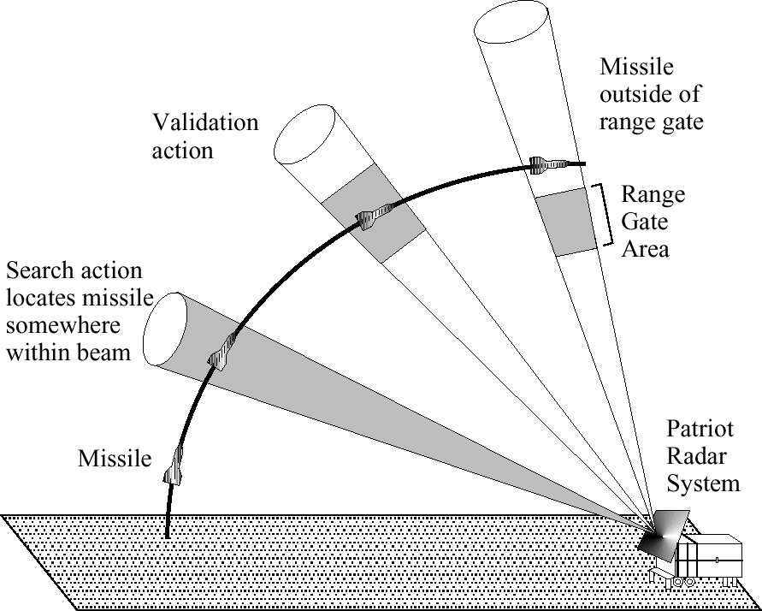
Effect of Loss of Precision
  • According to the General Accounting Office of the U.S. Government, a loss of precision in converting 24-bit integers into 24-bit floating point numbers was responsible for the failure of a Patriot anti-missile battery.
Notes:
Incident happens in Op. Dessert Storm (1991 – 1992).
Failed to intercept Scud missiles, hot Dhahran US barracks, killed 28 Americans.
Range gate position is based on detection by Patriot radar system
Conversion error cause the range gate to be shifted by 678 meters. Due to battery usage (more than 100 hours)
Fixes available 2 weeks before incident but distribution difficulties (wartime).

Slide 60
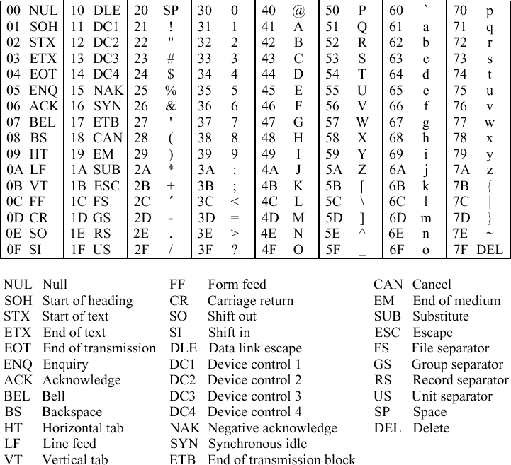
ASCII Character Code
  • ASCII is a 7-bit code, commonly stored in 8-bit bytes.
  • “A” is at 41₁₆. To convert upper case letters to lower case letters, add 20₁₆. Thus “a” is at 41₁₆ + 20₁₆ = 61₁₆.
  • The character “5” at position 35₁₆ is different than the number 5. To convert character-numbers into number-numbers, subtract 30₁₆: 35₁₆ - 30₁₆ = 5.
Notes:
American Standard Code for Information Interchange.
2⁷ = 128 possible characters
00 to 1F & 7F, special characters used for non-textual purposes (transmission, printing control etc)
Digits & letter appears in sequence (0-9, uppercase & lowercase A-Z)
Prob? Limited characters (128 only)

Slide 61
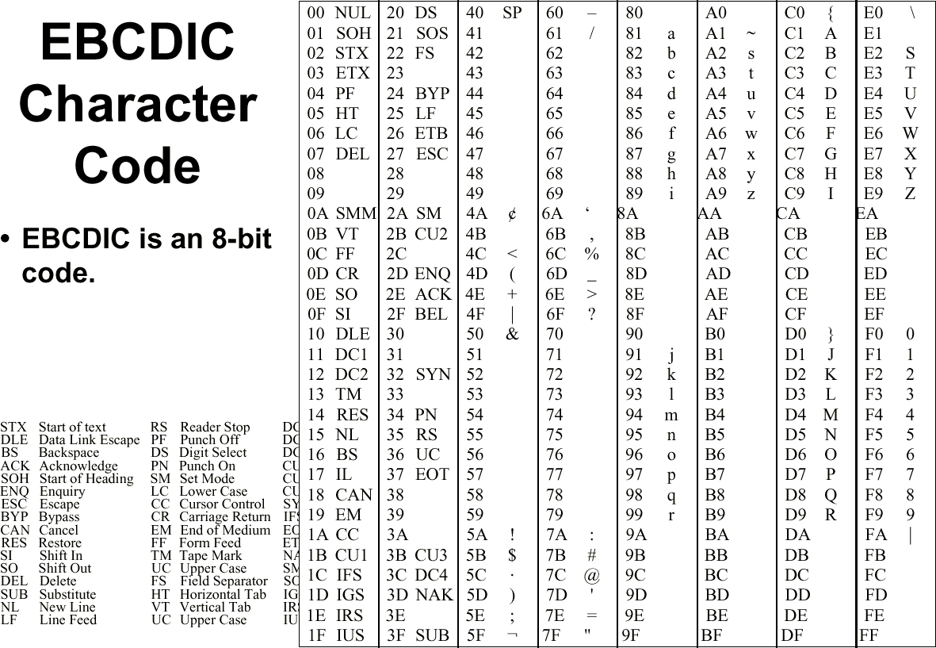
  • EBCDIC is an 8-bit code.
Notes:
Extended Binary Coded Decimal Interchange Code (ebsidik)
Used extensively in IBM mainframe & AS/400
Gaps is for application specific characters

Slide 62
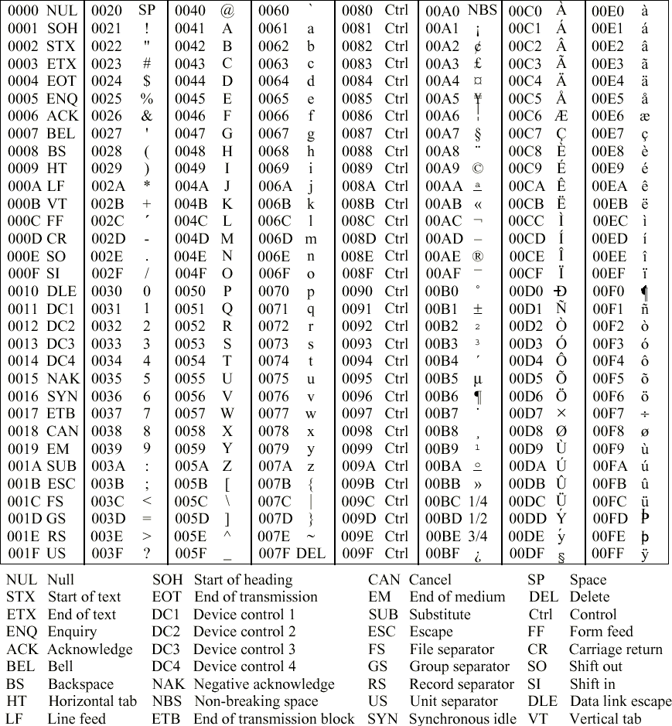
Unicode Character Code
  • Unicode is a 16-bit code.
Notes:
Both ASCII & EBCDIC only supports latin characters.
Developed and maintained by non profit organization called Unicode Consortium
Unicode – to support world’s character sets.
Version 4.0 – 96,382 distinct coded characters
Evolving standard.

Slide 63
Self Test
Convert the following numbers as indicated, using a few digits in the result as necessary.
  (47)₁₀ to unsigned binary
  (-27)₁₀ to binary signed magnitude
  (213)₁₆ to base 10
  (10110.101)₂ to base 10
  (34.625)₁₀ to base 4

Slide 64
Self Test
Convert the following numbers as indicated, using as few digits in the results as necessary.
  (011011)₂ to base 10
  (-27)₁₀ to excess 32 in binary
  (011011)₂ to base 16
  (55.875)₁₀ to unsigned binary
  (132.2)₄ to base 16

Slide 65
Self Test
For the following single precission IEEE 754 bit patterns, show the numerical value as a base 2 significand with an exponent (e.g. 1.11 x 2⁵). For ques. d & e, show the IEEE 754 patterns.
  0 10000011 01100000000000000000000
  1 10000000 00000000000000000000000
  1 11111111 00000000000000000000000
  +1.1011 x 2⁵ (single precision)
  -1.00111 x 2⁻¹ (double precision)

Slide 66
Self Test
Convert 45.45 to IEEE754 (single precision format)
Show numerical value as a base significant with an exponent
  0 00000001 10010000000000000000000
  0 00000011 01100100000000000000000

